Slide 1
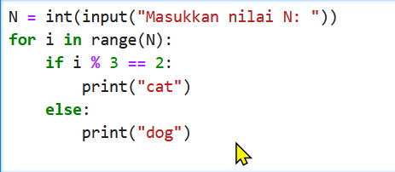
A store owner wants to create a cashier program that calculates the total payment based on the following conditions:
The customer will input the price of an item, the quantity of items, and the type of customer (member or non-member).
The price is of float type.
The quantity is of integer type.
The customer type is of string type.
The program must calculate the total price using the formula:
Total Price = (Price * Quantity)*Discount
Before calculating the total price, the program must validate the inputs:
If the price is less than or equal to 0, display an error message and request new input.
If the quantity is less than 1, display an error message and request new input.
After receiving valid input, the program calculates the total price:
If the customer is the total price is more than $500, the customer receives a 10% discount.
If the customer is the total price is $500 or less, the customer receives no discount.
The program should display the total price to be paid after applying the discount (if any).
Create a flowchart that represents the program’s logic, including input validation, branching for calculating discounts, and determining the customer type. (25%)
2.
Write Program code, with follow this rules: (30%)
If a number is divisible by 3, print "Papa".
If a number is divisible by 5, print "Mama".
If a number is divisible by both 3 and 5, print "PapaMama".
If the number is not divisible by either, print the number itself.
Input:
The user will input a number between 1 and 50. This number will represent the "index" of the Papa Mama sequence. For example, if the user inputs 5, the program should determine what to print for the number 5.
If the number is not between 1 and 50, the program should display an error message and ask for a valid input.
Example Input/Output:
If the user inputs 15, the program prints: "PapaMama".
If the user inputs 9, the program prints: "Papa".
If the user inputs 20, the program prints: "Mama".
If the user inputs 7, the program prints: 7.
Case Study Looping (15%)
show the application when it is running and create a flowchart

Slide 2
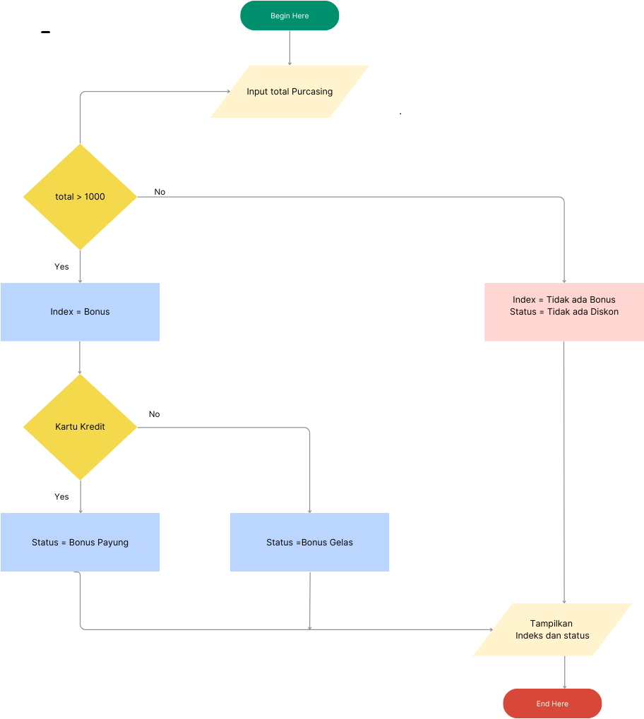
4.
Write Program code based on this flowchart: (30%)

